Slide 1
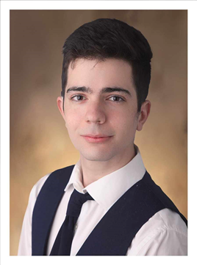
Made by: Bablina Balázs Bence & Zsichla Máté
Instant Courier Program

Slide 2
The solutions
The problem
There is no organized platform for couriers order
There is no option to choose a free courier
Instant courier
Organized platform for various means of transport
Unique offers

Slide 3
Functions of program for couriers
Registration of a delivery veichle (courier)
Login as a courier
Create a profile

Slide 4
Functions of program for customers
Registration of costumer
Login as user
Search of transport
Offer request

Slide 5
The program
HTML
CSS
JavaScript
PHP
Frontend - Angular
NgBootstrap
Angular Material
Database - MySQL
Entity Framework

Slide 6


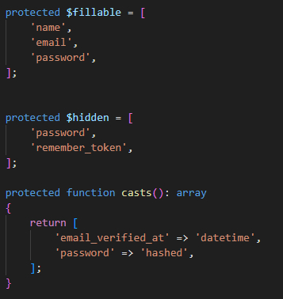

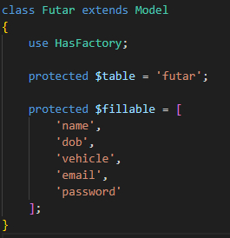
Models
User ->
Migration
Tables
Models -> „user.php” & „futar.php”
Courier ->

Slide 7
Controllers
http request type
Name of function
Extension
LINQ

Slide 8
Frontend

Slide 9

Database
MySQL
Model First
Entity Framework
2 tables
Loading data - courier
name
e-mail
transport veichle

Slide 10
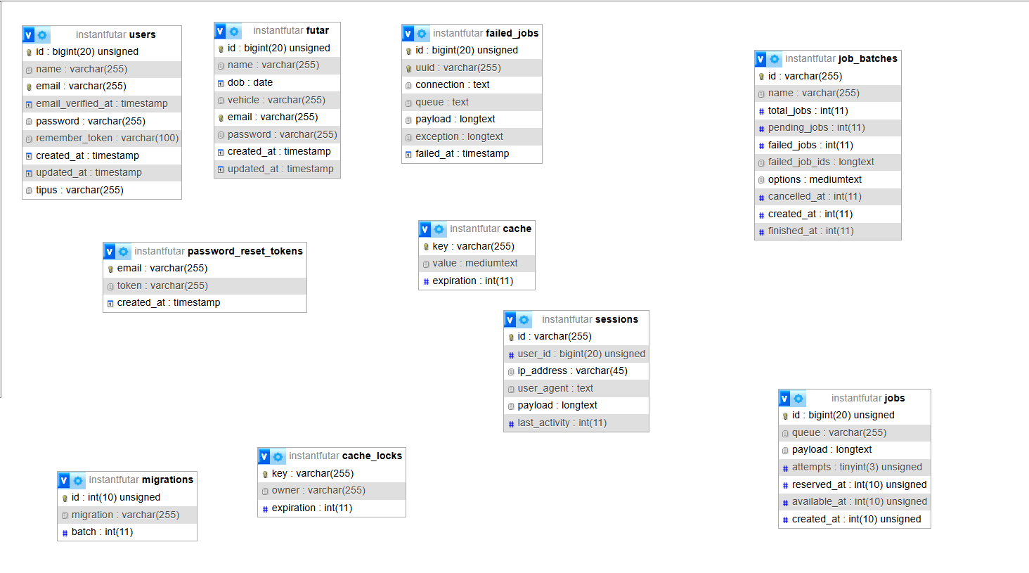

Slide 11
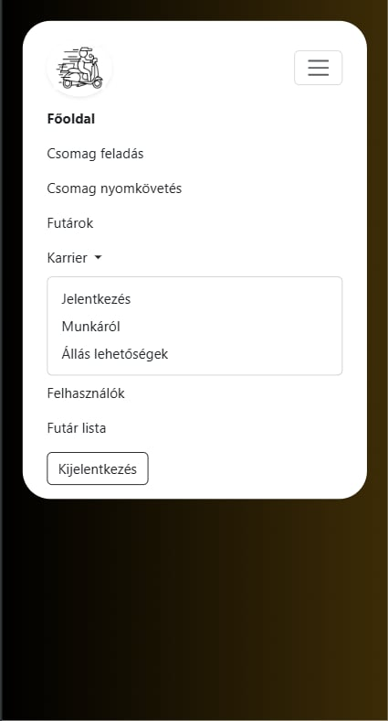
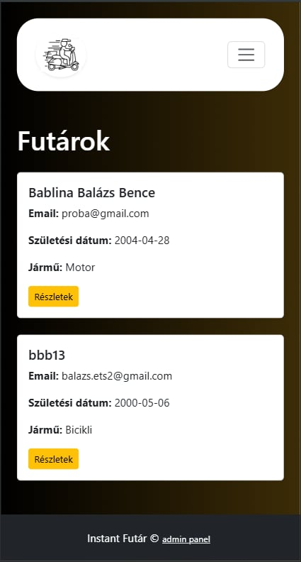

Responsivity
Optimized for mobile device
Acces for anywhere

Slide 12


Teamwork
GitHub
Teams
Divided by tasks, not files
Clean code

Slide 13
Teamwork - Backend
Bablina Balázs Bence
Controller:
AdminController
FelhasznaloController
FutarController
FutarListController
HomeController
Location Data Import
Zsichla Máté
Controller:
ConfirmPasswordController
ForgotPasswordController
LoginController
ResetPasswordController
VerificationController
JWT

Slide 14
Teamwork - Frontend
Bablina Balázs Bence
Component:
Login
Registry
Training
CreateTraining
ProfileSettings
AddSession
MainPage
Admin
Images
TagTraining
Zsichla Máté

Slide 15
Instant Courier demo

